Slide 1
plasm-O-pheresis
By Team codeBlooded

Slide 2
The idea behind plasm-O-pheresis
In the midst of the pandemic, plasma treatment came as a ray of hope. But, then emerged another problem of finding potential plasma donors.

Slide 3


Flaws in Plasma Bank
Requirement of infrastructure Plasma Banks demands a proper infrastructure.
Requirement of manpower It also demands for a huge manpower for proper administration and running of the plasma bank
Immobile A plasma bank can only serve for a particular city and town.

Slide 4
What is plasm-O-pheresis
plasm-O-pheresis - A web portal to solve the issue of finding a potential and suitable plasma donor.
It reduces the waiting time period of patients of finding a plasma donor.
Effective and easy to implement in rural areas too due to minimal prerequisites of infrastructure and manpower.

Slide 5
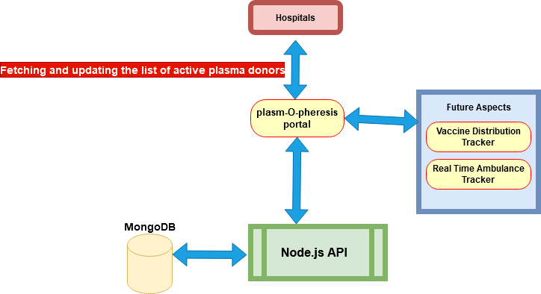
How plasm-O-pheresis works

Slide 6
Future Aspects
Corona vaccine distribution tracker
Blood donor database
Ambulance tracker

Slide 7
About us
Team - Team codeBlooded
Led by - Shivam Shekhar
Team Members - Shubhra Agarwal, Ankit Das
Theme - Health Technology in Rural Areas

Slide 8
Thank you!

